Slide 1
Linux basic
2025.11.28 FRI

Slide 2

Outline
Intro of Linux (usage, history, founder…)
OS (operating system)
Linux System Architecture
Linux installation
Basic Terminal / CLI use

Slide 3
Who is recommend to learn Linux?
Server engineers
Software / backend / OS developer
Machine learning / Data science
All CS students

Slide 4
Value and application of Linux
Almost all cloud infrastructure and web servers use Linux as OS (E.g. csubuntu)
The premier platform for the software development.
Derived other OS [Android / some embedded system.]
Unique Pros:
Open-source
Security-enhanced
Fast

Slide 5
Founder and History
Linus Torvalds – Founder of Linux and Git.
Unix (1969) and Minix (1984)
Linus developed the kernel as a personal project in 1991.
"Hello everybody out there using minix - I'm doing a (free) operating system (just a hobby, won't be big and professional like gnu)... It is now ready to be used." — Linus Torvalds, October 5, 1991, at the University of Helsinki.
Linux kernel released V1.0 under the GPL license in 1992.
Global community adopts and improves it, in 1990s.
Multiple versions and mainstream OS for developers, 2000s – today.

Slide 6




OS (Operating System)
Manage and control hardware and software resources within computer systems to facilitate the exchange of information between users and system hardware.

Slide 7
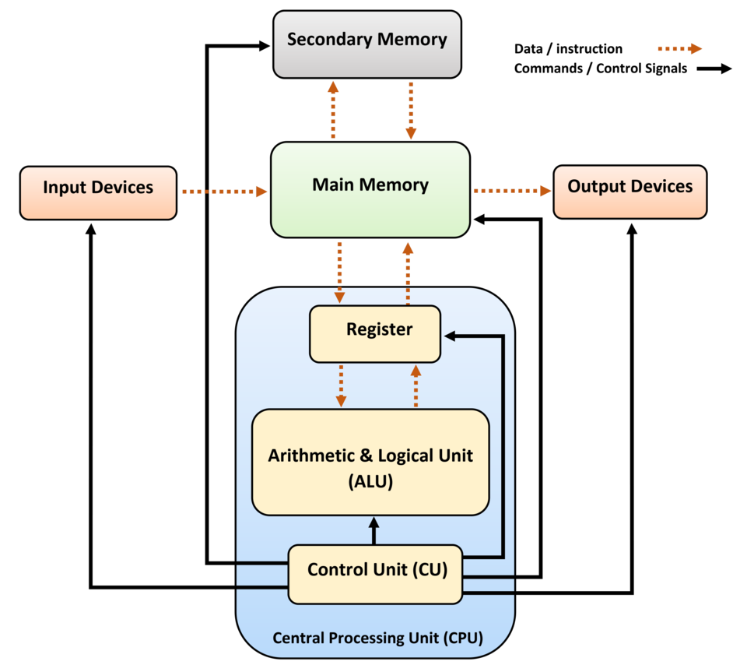
OS (Operating System)
Manages Hardware
- Controls the CPU, memory, disk drives, printers, etc.
Provides a User Interface
GUI (Graphical User Interface):
The visual desktop with windows, icons, and menus.
(e.g., Windows, macOS, Ubuntu Desktop).
CLI (Command Line Interface):
A text-based interface where you type commands
Runs Applications
- Support web browsers, games, and word processors.
Manages Files and Folders

Slide 8
Linux System Architecture
Linux Version
Linux OS System Components
File System / Structure
Multiple user management
Application

Slide 9
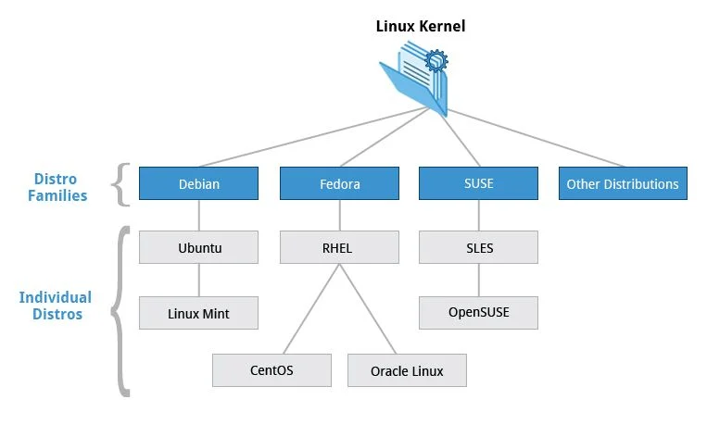
1. Linux Version
Linux kernel with its distribution
Linux kernel + commonly used apps
-> Linux Release Ver.
Debian (Ubuntu) & RHEL are the
most popular release version.
For example, ubuntu provides a GUI.
That’s one of the reasons that makes
Ubuntu a beginner-friendly Linux.

Slide 10
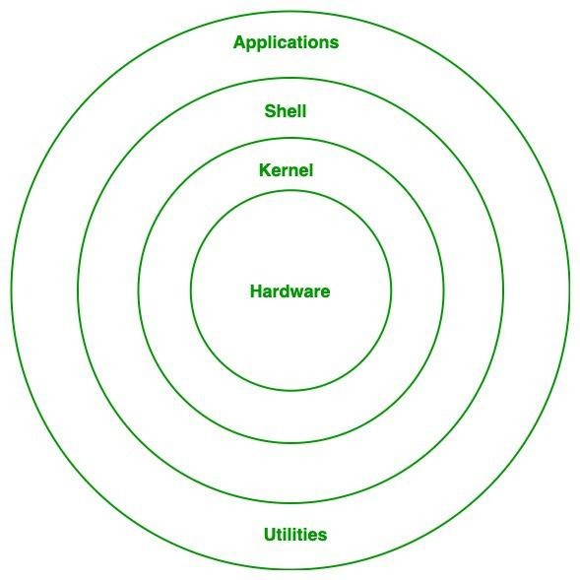
2. Linux OS System Components
Like any operating system, Linux consists of software, computer programs, documentation, and hardware.
The main components of Linux operating system are:
Application, Shell, Kernel, Hardware, Utilities
Components of Linux

Slide 11
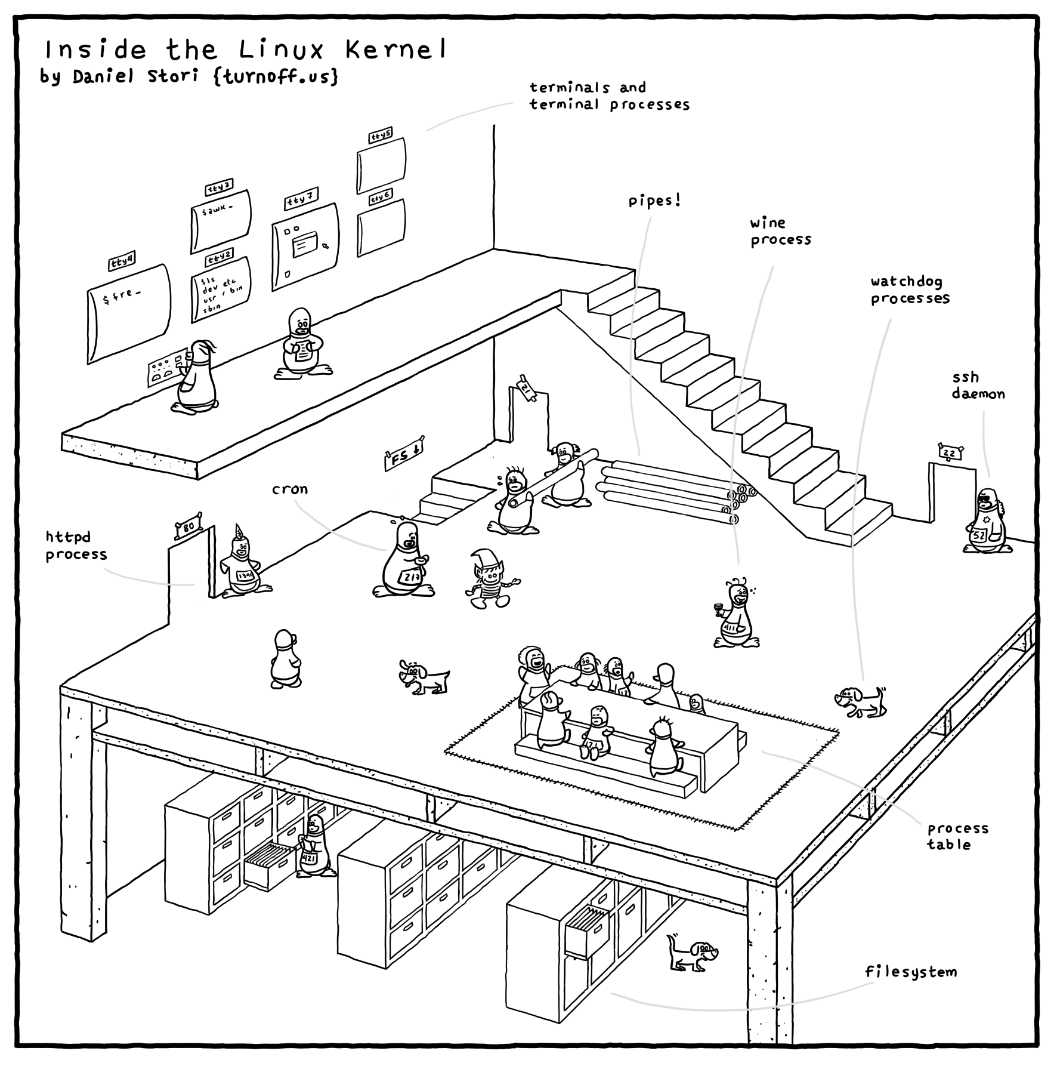
2.1 Kernel
Kernel is the main core component it is lies between the shell and the hardware.
It controls the activity of other hardware components.
It visualizes the common hardware resources and provide each process with necessary virtual resources.
It makes the process to wait in the ready queue and execute in consequently to avoid any kind of conflict.
Notes:
The kernel is software that manages communication between the hardware and the system.
It cannot directly interact with directories or files.
Instead, the kernel handles the communication between the computer system and the hardware.

Slide 12
Kernel is responsible for:
Memory management: Manages and allocates memory efficiently.
Resource allocation: Distributes system resources to different processes.
Device management: Controls input/output devices like printers and scanners.
Process management: Manages process execution and scheduling.
Application interaction: Bridges applications with system-level functions.
Security: Provides essential system-level security.
Notes:
[Also different types and ]

Slide 13
2.2 Shell
The Shell is also software or it can be determined as the interface to the kernel.
It takes commands from the user and interprets them.
The shell transmits these commands to the kernel, which then performs the requested operations.
Notes:
Users can just enter the command and using the kernel's function that specific task is performed accordingly.

Slide 14
2.x Others
System Library
GNU C library / libstdc++
Math library
Dynamic Linker
Hardware Layer
The lowest level of operating system track.
Device drivers, memory management, CPU control, I/O operations.
System utility
The command line tools that preforms various tasks provided by user.
To make system management and administration better.

Slide 15
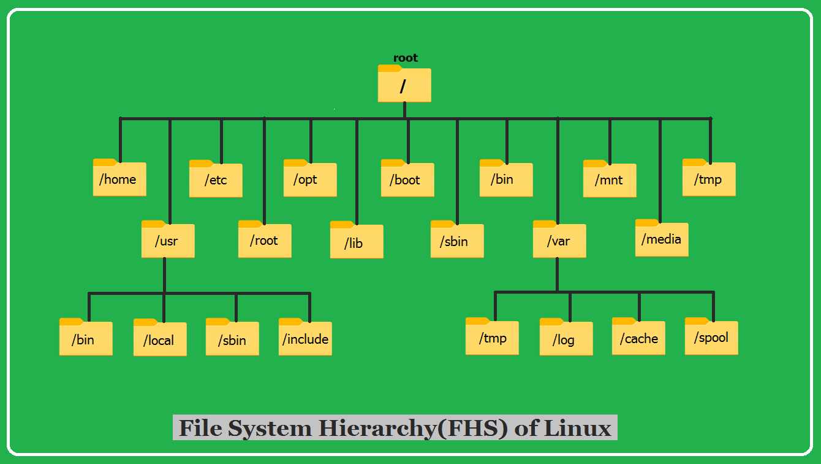
3. File system / structure
Notes:
Like a tree, like windows.
VFS (Virtual File System)

Slide 16
4. Multiple user & permissions
OS allows multiple user exists on the same device.
Users can be divided into:
Regular users
Root user (Superuser)
User groups (groups of users)
Why?
For cooperation
For security

Slide 17
Permission of files
Owner
Owner group
Others
d-rwx-rwx-rwx
Read - R
Write - W
Execute – X

Slide 18
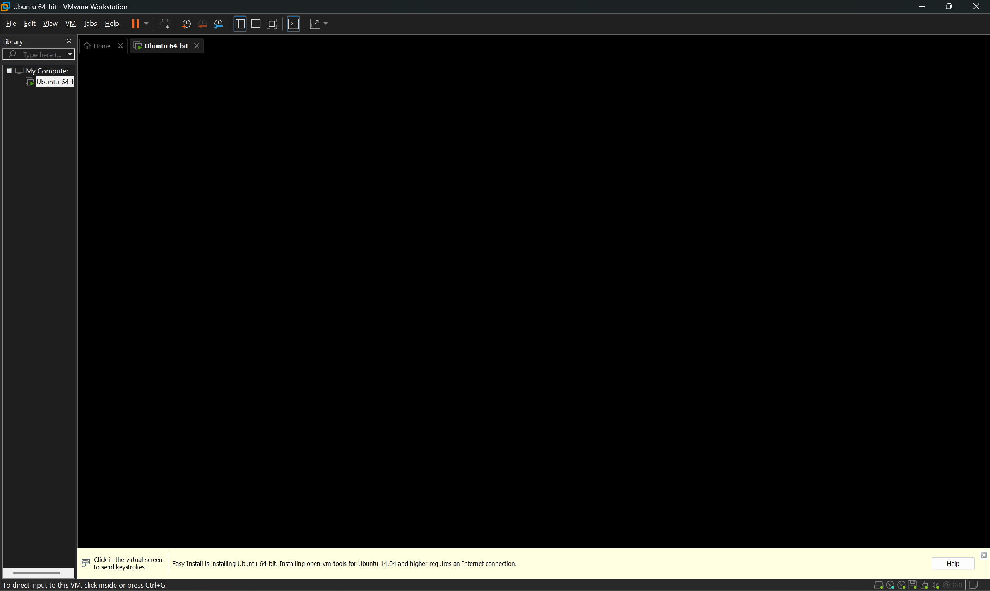
About Linux OS installation
Directly set Linux as your OS. -- Not recommended
Using virtual machine
For windows, WSL is also a good choice (Windows Subsystem for Linux.)
For study only, connect to school’s server (csubuntu) or use some online simulation project.
Version selection: Ubuntu LTS / latest ver.

Slide 19
Linux Software Installation
On windows, people search for the .exe file
This will cause the problem of dependency.
E.g. Video games -> DirectX; Java apps -> JDK
Linux provides a powerful tool called Package Managers.
The dependency will be automatically fetched and installed
Just like what the ‘pip’ or ‘conda’ did.
pip install torch / conda create –n name python = 3.10
A CLI tools on installing, updating or removing.

Slide 20
Package and Manager
Package
The compiled software program
Metadata (name, version, description)
A list of its dependencies
Installation scripts
Package manager
It is an app so it’s not in the kernel.
For Debian / Ubuntu, it is consists of DPKG & apt.
The usage of apt will be shown later at the CLI part.
Notes:
Package could be a GUI app, or a cmd tool, or a dependency tool.

Slide 21
Basic terminal / CLI use
GUI vs. CLI
Windows, Icons, Menus, Pointer (WIMP) vs. text-based comments
Friendly to users vs. extremely fast processing & less resource occupy.
Although common OS provides GUI, CLI is preserved for its pros.
Windows: Search for CMD / PowerShell / Terminal
MacOS / Linux: Terminal
Now try to open the Terminal on your Linux.

Slide 22
Terminal Use 1: Directory related cmd
cd
ls
mkdir
pwd
rm

Slide 23
Terminal Use: format and advice
All the commands keep a format like this:
command [options] [arguments]
command –h, --help
rm –d --directory.
cd ~
Quick operations:
Tab – auto implement
Up/down – previous / next command
ctrl + c – Force end command / program
No need to memorize all; but learn the rules and search for wiki.

Slide 24
Terminal Use 2: File and other common cmd
clear
./file
cat
touch
mv
cp

Slide 25
Terminal Use 3: Permission related cmd
sudo
Use this for every cmd that requires super / root user permissions.
Any op that may damage the system security / violence policy.
cd to other user’s directory
Install apps (because app is installed for all users)
Operation with user management
useradd -> sudo useradd

Slide 26
Terminal Use 4: File permission cmd
chmod [ugoa][+-=][target]
Others share a file with you. But you cannot execute it.
chmod u+x filename
chmod a-w filename

Slide 27
Terminal Use 5: Installation cmd
Note that using official package manager: DPKG & apt requires sudo
apt install <package_name1> <package_name2>
apt update <package_name>
apt remove <package_name>
apt search <keyword>
apt list –installed
brew as a third-party package manager tool
brew install <package_name>

Slide 28
Thanks for listening.

Slide 29
Reference
https://www.geeksforgeeks.org/linux-unix/architecture-of-linux-operating-system/
https://tecadmin.net/filesystem-hierarchy-structure-in-linux/
https://www.geeksforgeeks.org/linux-unix/linux-file-system/
https://ubuntu.com/
https://labex.io/learn/linux

